Slide 1
Listeria
Most Listeri species are
small, Gram-positive, coccobacilli
rods, up to 2 micro meter in length
The colonies are small, smooth and
transparent after incubation for 24 hrs
catalase-positive, oxidase-negative, motile, facultative anaerobes.

Slide 2
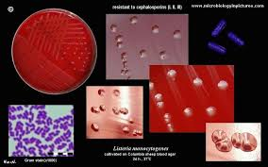

Slide 3
The genus is composed of six species, three of which are pathogenic.
Listeria monocytogenes, the most
important of these pathogens,
L. ivanovii and L. innocua, are less frequently implicated in diseases of animals

Slide 4
Listeria monocytogenes has been implicated worldwide in diseases of many animal species and humans.
It was first isolated from laboratory rabbits with septicaemia and monocytosis .

Slide 5
Listeria monocytogenes can grow over a wide temperature range from 4°C to 45°C and
can tolerate pH values between 5.5 and 9.6.
L.monocytogenes can survive freezing

Slide 6
Water activity (a_{w})
  LM grows well at a_{w} of >0.95; can multiply at a_{w} of 0.90
  Some LM can survive at a_{w} of <0.90
Salt concentration
  Growth at 10%
  Survival at 25.5%

Slide 7
Key points
Small, Gram-positive rods
Grow on non-enriched media
Tolerates wide temperature and pH ranges
Small haemoly tic colonies on blood agar
Facultative anaerobes, catalase-positive,
oxidase-negative
Tumbling motility at 25°C
Aesculin hydrolysed
= Environmental saprophytes
Outbreaks of listeriosis often related to silage food

Slide 8
Usual habitat
Listeria species can replicate in the environment.
They are widely distributed and can be recovered from herbage,
faeces of healthy animals, sewage and bodies of fresh water.

Slide 9
Differentiation of Listeria species
The pattern of haemolysis on sheep blood agar,
CAMP tests
acid production from a short range of sugars
Commercially-available biochemical test kits
Sixteen serotypes, based on cell wall and flagellar antigens

Slide 10
Phage typing
A DNA probe assay is available for rapid and specific identification of L. moncrcytogeaes
DNA fingerprinting methods are currently used in
reference laboratories

Slide 11
Pathogenesis and pathogenicity
Infection with L. monocyiogenes usually follows ingestion of contaminated feed and may result in septicaemia, encephalitis or abortion. Organisms probably penetrate the M cells in Peyer's patches in the intestine. Spread occurs via lymph and blood to various tissues.
In pregnant animals, infection results in transplacental transmission.
There is evidence that the organism can invade through breaks in the oral or nasal mucosa. From this site, migration in cranial nerves is thought to be the main route

Slide 12
Lisleria monocytogenes has the ability to invade both
phagocytic and non-phagocytic cells, to survive and
replicate intracellularly and to transfer from cell-to-cell without exposure to humoral defence mechanisms.
Specific surface proteins, internalins, faditate both the adherence of organisms to host membranes and their subsequent uptake.
Virulent strains also possess a cytolytic toxin, listeriolysin, which destroys the membranes of phagocytic vacuoles allowing listeria to escape into the cytoplasm.

Slide 13
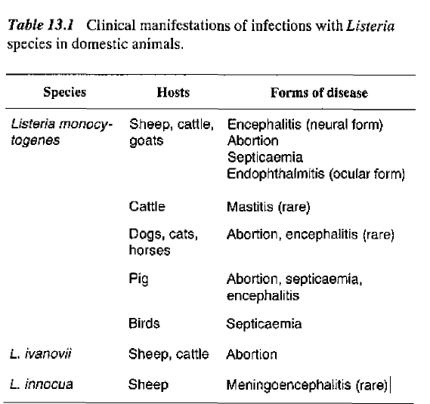

Slide 14
Clinical signs
The incubation period of neural listeriosis (circling
disease) ranges from 14 to 40 days. Dullness, circling and tilting of the head, are common clinical signs.
Unilateral facial paraIysis results in drooling of saiiva and drooping of the eyelid and ear. Exposure keratitis may occur in some cases.
Body temperature may be elevated in the
early stages of the disease.

Slide 15
In sheep and goats, recumbency and death may follow within a few days of the emergence of clinical signs. The duration of illness is usually longer in cattlc. Abortion, without evidence of systemic illness may occur up to 12 days after infection.
cattlc and sheep, keratoconjunctivitis and iritis (ocular listeriosis) are localized, often nilateral and have been attributed to direct contact with contaminated silage.

Slide 16
Diagnosis
Characteristic neurological signs or abortion in association with silage feeding may suggest listeriosis.
-Cerebrospinal fluid {CSF) and tissue from the medulla and bons of animals with neurological signs should be sampled.
> Fresh tissue is required for isolation of organisms and fixed tissue for histopathological examination.

Slide 17
-Specimens from cases of abortion should include cotyledons, foetal abomasal contents and uterine discharges.
-Suitable samples from septicaemic cases include fresh liver or spleen and blood.
Smears from cotyledons or from liver lesions may reveal Gram-positive coccobacilIary bacteria.

Slide 18
Isolation methods:
-Specimens from cases of abortion and septicaemia
can be inoculated directly onto blood, selective
blood and MacConkey agars. The plates are
incubated aerobically at 37'C for 24 to 48 hours.
--A cold-enrichment procedure is necessary for isolating the organism from brain tissue. Small pieces of medulla are homogenized and a 10% suspension is made in nutrient broth. The suspension is held at 4°C in a refrigerator and subcultured weekly onto blood agar for up to 12 weeks.

Slide 19
Identification criteria for L, monocytogenes isolates:
-Colonies are small, smooth and flat with a bluegreen colour when illuminated obliquely. Rough variants occur infrequentiy. Individual colonies are usualIy surrounded by a narrow zone of complete haemolysis.

Slide 20
- Catalase test is positive, distinguishing this organism
from streptococci and Arcanobacterium pyogenes
which have similar colonies but are catalase negative.
- CAMP test is positive with Staphylococcus aureus
but not with Rhododoccur equi
- Acsculin is hydroly sed.
-Isolates incubated in broth at 25'C for 2 to 4 hours
exhibit a characteristic tumbling motility.
-Most isolates of animal origin are virulent, a characteristic which can be confirmed by animal
inoculation. Instillation of a drop of broth culture
into the eye of a rabbit induces keratoconjunctivitis
(Anton test).

Slide 21
Treatment
Ruminants in the early stages of septicaemic listeriosis respond to systemic therapy with ampicillin or amoxicillin.
Response to antibiotic therapy may be poor in neural listeriosis although prolonged high doses of ampicillin or amoxicillin combined with an aminoglycosidc may be effective. Ocular listeriosis requires treatment with
antibiotics and corticosteroids injected sub-conjunctivally

Slide 22
Control
Poor-quality silage should not be fed to pregnant ruminants.
- Silage feeding should be discontinued if an outbreak of listeriosis is confirmed.
Feeding methods which minimize direct ocular contact
with silage should be implemented.

Slide 23
Vaccination with killed vaccines, which do not induce an effective cell-mediated response, is not protective because L. monocytogenes is an intracellular pathogen.
Live, attenuated vaccines, which are available in somecountries, are reported to reduce the prevalence of listeriosis in sheep (Gudding et al., 1989).

Slide 24
Human listeriosis
If normal healthy adults acquire infection, the disease usually presents as a mild febrile illness resembling influenza.
Papular lesions on the hands and arms, principally in veterinarians and farmers, can result from contact with infective material.
Infection with L. monocytogenes can lead to abortion in pregnant women and can be life-threatening in neonates, the elderly and in immunosuppressed individuals.

Slide 25
Human infections usually result from consumption of
contaminated food such as raw milk, soft cheeses,
and uncooked vegetables.
Listeria monoctogenes
may survive pasteurization because of its intracellular
localization and toIerance to heat.
Direct transfer from infected animals to humans is uncommon and is of little consequence in healthy, non-pregnant individuals

